Slide 1

Automation of Resume Shortlisting
April 2019

Slide 2

AGENDA
Definition
Problem Statement
Target Solution
Challenges faced
Exploratory Data Analysis
Dataset
Text mining
Solution Architecture
Algorithms used
Classification
Recommendation
Model Performance
Key metrics
Findings
Conclusion
Limitations & Next steps

Slide 3
Problem Statement & Intended Solution

Slide 4



Glaring Reflections in Recruitment process
High volumes : Manual effort
Irrelevant applicants
Waste of engineering time
Confession of hardships
23
88%
50
52%
Hours spend in sorting through resumes, per hire
Applicants turn out to be unqualified for the job
Hours spent on interviewing and follow ups
Of talent leaders admit that hardest part in recruitment is screening
77%
Need of the hour is of effective pre screening
Provide a better candidate experience – unnecessary interviews can be avoided
Eliminate human-bias & focus on skill based hiring
Of business leaders prefer human interaction at key checkpoints
Automate yet personalize!
Ref : OvumKC APAC HR survey 2018

Slide 5
Our Solution
Do away with massive screening efforts in high volume markets/domains
Bring efficiencies in recruitment process
Separating right candidates from the pack
Making sense of candidate CVs
Knowing that candidates can do the job before you hire them
Automation of “Top of the funnel” process only
Resume Classification
Resume ranking wrt Job Description
Effective screening can reduce Screen to Offer time by 48%

Slide 6
Challenges Faced
Get to heart of users’ pains
Limited Exposure to Text Mining at the start
Data Acquisition

Slide 7
Exploratory Data Analysis

Slide 8
DATASET
Data downloaded from online portal(s) and from Kaggle
Data in Excel Format
Description of the Data Set :
ID - Sequence number of the resume
Category - Industry sector to which the resume belongs to
Resume - The complete CV of the candidate

Slide 9
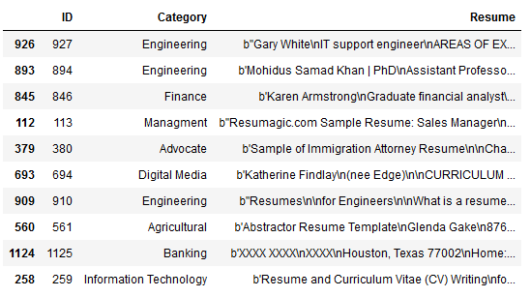
DATASET Sample

Slide 10
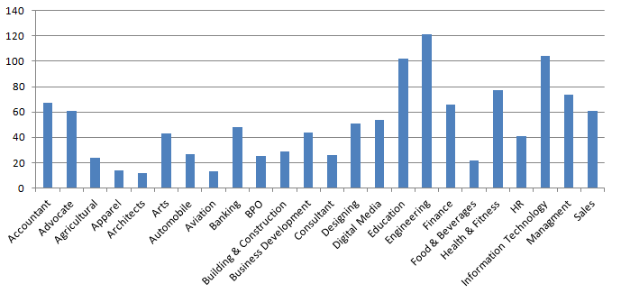
Data Distribution
Effective screening can reduce Screen to Offer time by 48%

Slide 11
Solution Architecture

Slide 12
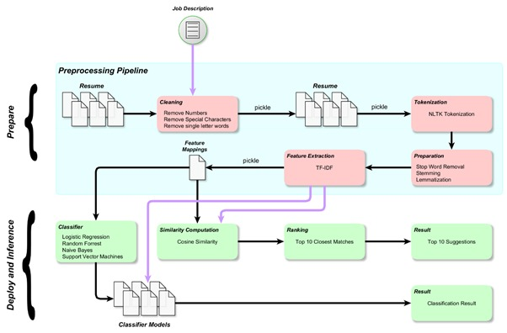
Architecture Diagram

Slide 13
EDA – Data Pre Processing
Data Cleaning Steps:
Mask string fragments like \x
Mask string fragments for escape sequences like \a \b \t \n
Mask all numbers
Replace all the single letter words with empty string
Mask email addresses
Stop words were masked from the dataset
Lemmatization CVs

Slide 14
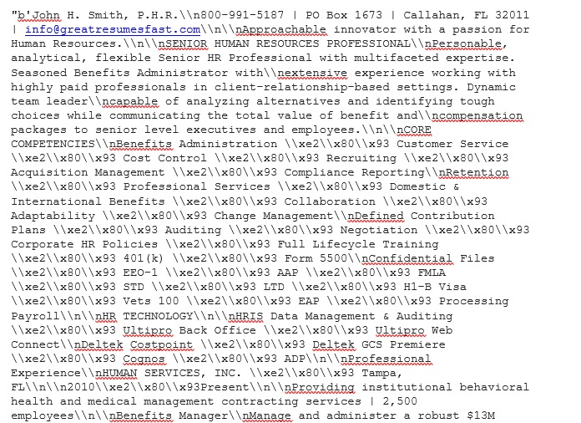
Before Cleaning
Do away with massive screening efforts in high volume markets/domains
Bring efficiencies in recruitment process
Separating right candidates from the pack
Making sense of candidate CVs
Knowing that candidates can do the job before you hire them
Automation of “Top of the funnel” process only
Resume Classification
Resume ranking wrt Job Description
Effective screening can reduce Screen to Offer time by 48%

Slide 15
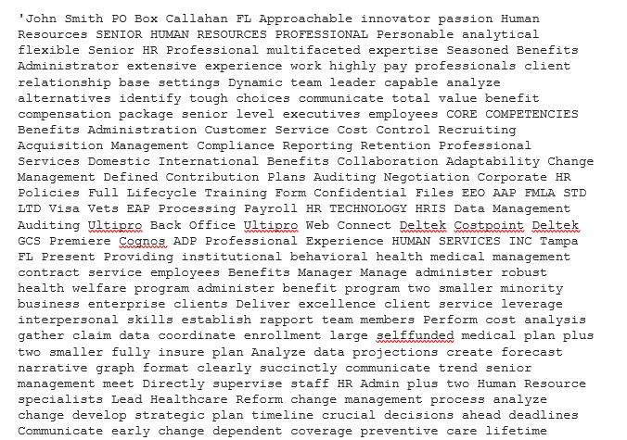
After Cleaning
Effective screening can reduce Screen to Offer time by 48%

Slide 16
TFIDF Motivation
Classifiers and learning algorithms cannot directly process the text documents
Expect numerical feature vectors with a fixed size rather than the raw text documents with variable length
Common approach is bag of words model
Calculate a measure called Term Frequency, Inverse Document Frequency
sklearn.feature_extraction.text.TfidfVectorizer to calculate a tf-idf vector :
sublinear_df : True ( logarithmic form for frequency)
min_df : 5 ( minimum numbers of documents a word must be present in to be kept)
norm :l2 (ensure all our feature vectors have a Euclidian norm )
gram_range is set to (1, 3) ( we want to consider unigrams ,bigrams and trigrams)
stop_words :"english" ( remove all common pronouns ("a", "the", ...) to reduce the number of noisy features)

Slide 17
Algorithms used

Slide 18
Classification
The classification was done using 4 different models :
Random Forest
Multinomial Naive Bayes
Logistic Regression
Linear Support Vector Classifier

Slide 19
Accuracy Score
Accuracy of all the models was calculated using cross validation.
The average accuracy of each model is:
Random Forest - 0.3899
Multinomial Naive Bayes - 0.4439
Logistic Regression - 0.6240
Linear Support Vector Classifier - 0.7153

Slide 20
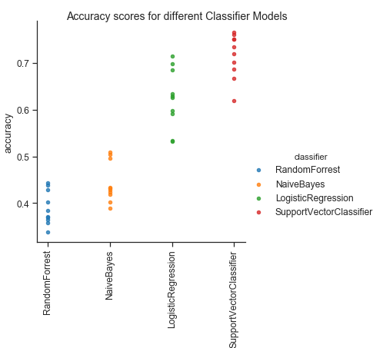
Accuracy
Do away with massive screening efforts in high volume markets/domains
Bring efficiencies in recruitment process
Separating right candidates from the pack
Making sense of candidate CVs
Knowing that candidates can do the job before you hire them
Automation of “Top of the funnel” process only
Resume Classification
Resume ranking wrt Job Description
Effective screening can reduce Screen to Offer time by 48%

Slide 21
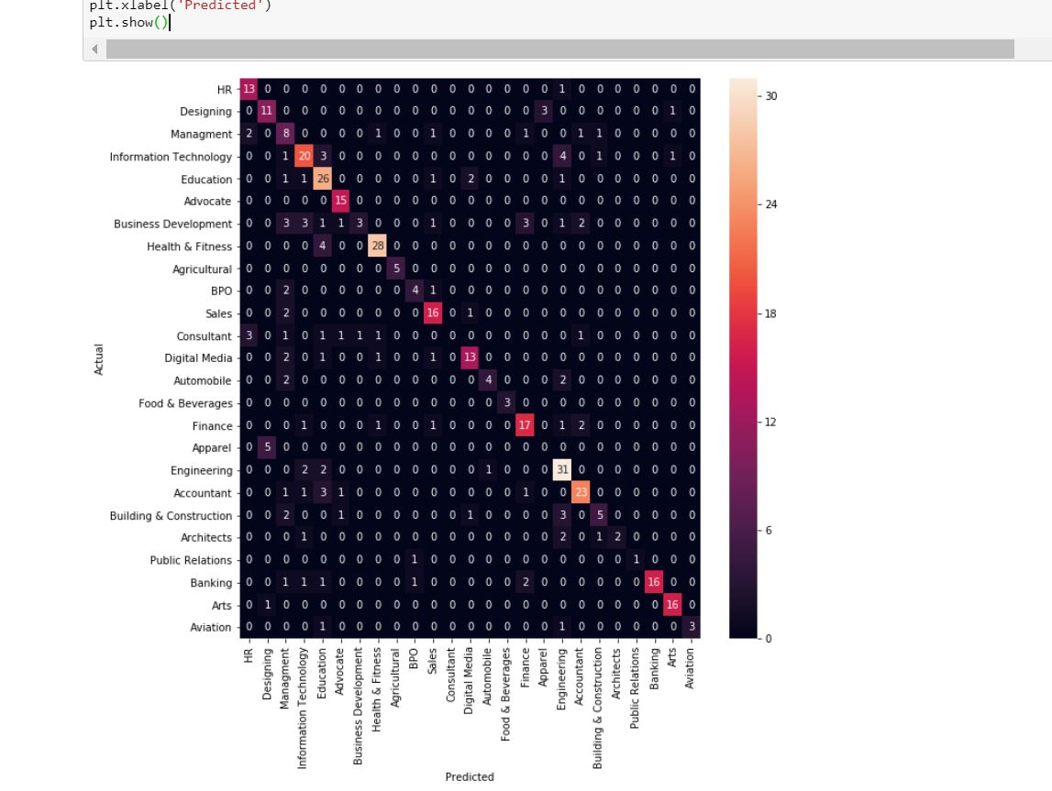
Confusion Matrix
Do away with massive screening efforts in high volume markets/domains
Bring efficiencies in recruitment process
Separating right candidates from the pack
Making sense of candidate CVs
Knowing that candidates can do the job before you hire them
Automation of “Top of the funnel” process only
Resume Classification
Resume ranking wrt Job Description
Effective screening can reduce Screen to Offer time by 48%

Slide 22
Recommendation
Recommendation model is designed to take job description and CV’s
CVs as input
Output as list of CVs (which are closest to the provided job description)

Slide 23

Recommendation Approach
This has been done using two approaches
Content Based Recommendation (Cosine Similarity)
k-nearest neighbours

Slide 24
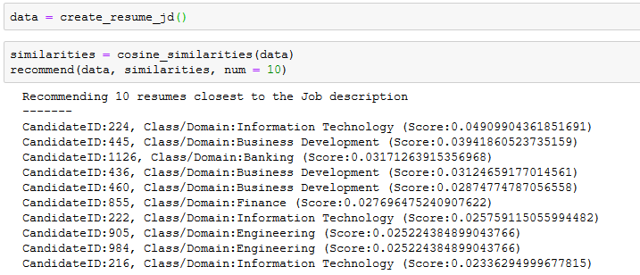
Job Recommendation
Do away with massive screening efforts in high volume markets/domains
Bring efficiencies in recruitment process
Separating right candidates from the pack
Making sense of candidate CVs
Knowing that candidates can do the job before you hire them
Automation of “Top of the funnel” process only
Resume Cob Description

Slide 25
Limitation & Next steps

Slide 26
Limitation & Next Steps
There are few limitation to the model design as of now, but these can be overcome by having more data to train the model.
The current limitation of the model are
1. Model takes CVs in CSV format, but in real world the CVs are either in .doc, .pdf etc format.
2. The library "gensim" which is being used for generating summary for CVs and JDs, might cause the important feature to be lost in the conversion.

Slide 27
Thank You!
Group 1 (PGP ML)
Amit Kapoor
Ankur Girdhar
Avinash Singh Jawa
Rocky Bhatia
Sarabjeet Singh Chowdhary

Slide 28
References
[1] S. T. Al-Otaibi and M. Ykhlef, “A survey of job recommender systems,” International Journal of Physical Sciences
[2] J. K. Tarus, Z. Niu, and A. Yousif, “A hybrid knowledge based recommender system for e-learning based on ontology and sequential pattern mining,”
[3] Jie Chen, Chunxia Zhang, and Zhendong Niu “A Two-Step Resume Information Extraction Algorithm”

